Slide 1
Soa services
Technical - Overview
Integration Team
July 2017

Slide 2
AGENDA
Overview
SOA Overview
Logical Fields
Payment Data Object (aka PDO)
Samples

Slide 3
“
GPP leverage Service-Oriented Architecture (SOA). Each service is an unassociated, self-supporting functionality. A business flow of messages is a cluster of services set in a predefined order which provide GPP's range of functionality”
GPP SOA List of Services – Technical Guide

Slide 4


SOA OVERVIEW
Action
GPP
MQ
Data Load
File
SOA Layer
Interface Layer
Task
WS
List
Database
UI

Slide 5

SOA specifications
Protocol – SOAP over HTTP
Format – XML
Transactional
Authorization Based
Specifications provided in WSDL format
Can be consumed by any client application

Slide 6
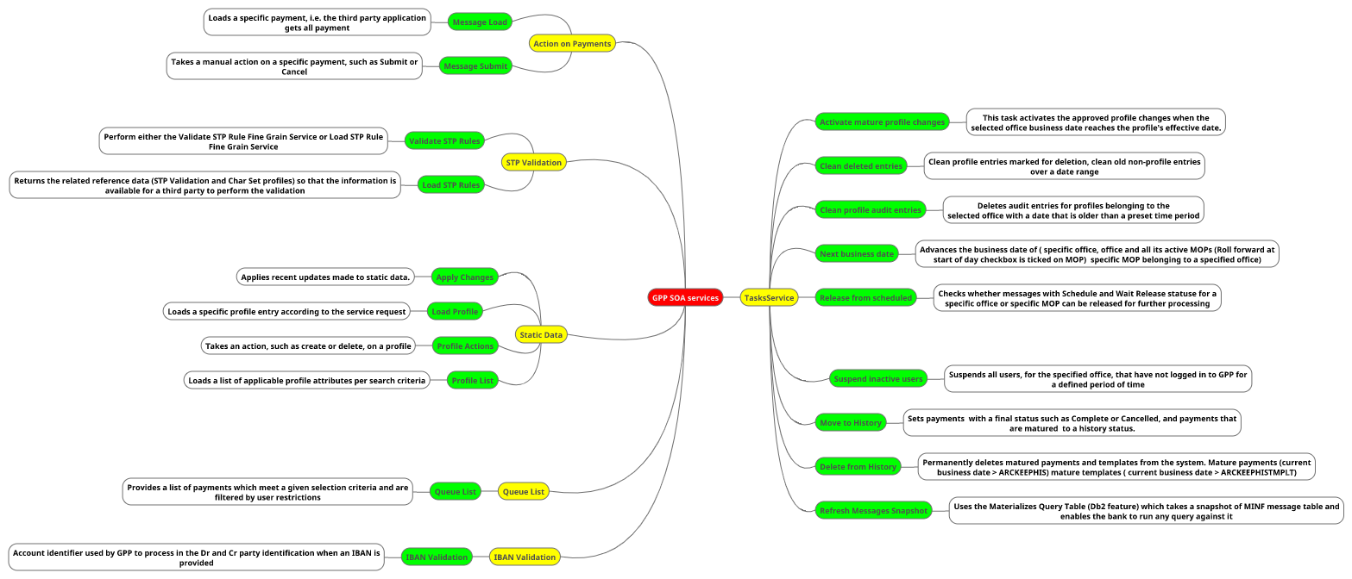
SOA services

Slide 7
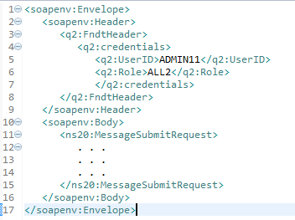
soa- example
SOA Message
Header
Service Body

Slide 8
Thank you
Rajesh Badiye
Integration Team
Rajesh.badiye@finastra.com

